Slide 1
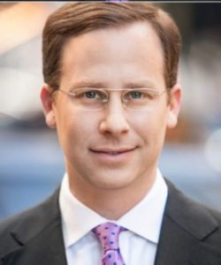
Strategies & Techniques to Encourage
Employee Creativity and Innovation
December 2, 2022
Presented by: Jonathan Weinberger
Chief Advocate for Advanced Technology Policy
General Motors
Organized by The American Foundation for Educational Excellence (AFEE) and the International Foundation for Women’s Empowerment (IFWE).
Ethics, Innovation, & Inclusive Leadership
© 2022, All Rights Reserved

Slide 2
Learning Outcomes
Explore lessons learned throughout a career defined by championing breakthrough solutions and innovations to tackle some of the world’s most pressing transportation challenges.
Learn how to channel passion for the job to reach success, and to explore the importance of including the passion factor in your organization’s vision, mission, and culture.
Discuss the importance of trusting personal intuition (to create and innovate) and incorporating that in organizational strategy and planning, namely in vision and mission.
Identify the importance of efficiently managing time and deadlines to enhance performance and productivity.

Slide 3
Agenda
Lessons learned throughout a career defined by championing breakthrough solutions and innovations
Channeling passion for the job to reach success
  Including the passion factor in organization’s vision, mission, and culture
Trusting personal intuition to create and innovate
  Incorporating that in organizational strategy and planning, namely in vision and mission.
Efficiently managing time and deadlines to enhance performance and productivity.

Slide 4
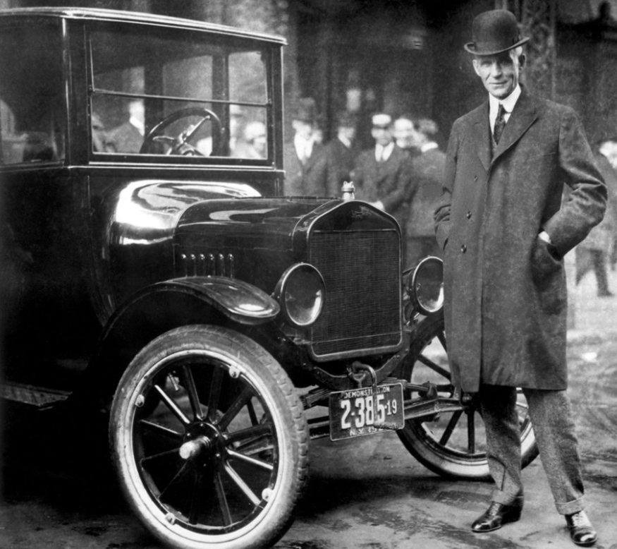
1. Lessons learned throughout a career defined by championing breakthrough solutions and innovations
“If I had asked people what they wanted, they would have said faster horses.”
-attributed to Henry Ford

Slide 5
From experience, here are some key characteristics that make up an innovative business leader:
1. Do things differently or do things that have never been done before.
2. Hire people who are passionate about their work.
3. Understand that innovation never happens in a vacuum.
4. Are committed to diversity.
5. Let go of high-control, low-trust model of leadership.
6. Understand that innovation is not a one-time thing.
7. Do not pay too much attention to traditional business metrics.

Slide 6
Agenda
Lessons learned throughout a career defined by championing breakthrough solutions and innovations
Channeling passion for the job to reach success
  Including the passion factor in organization’s vision, mission, and culture
Trusting personal intuition to create and innovate
  Incorporating that in organizational strategy and planning, namely in vision and mission.
Efficiently managing time and deadlines to enhance performance and productivity.

Slide 7


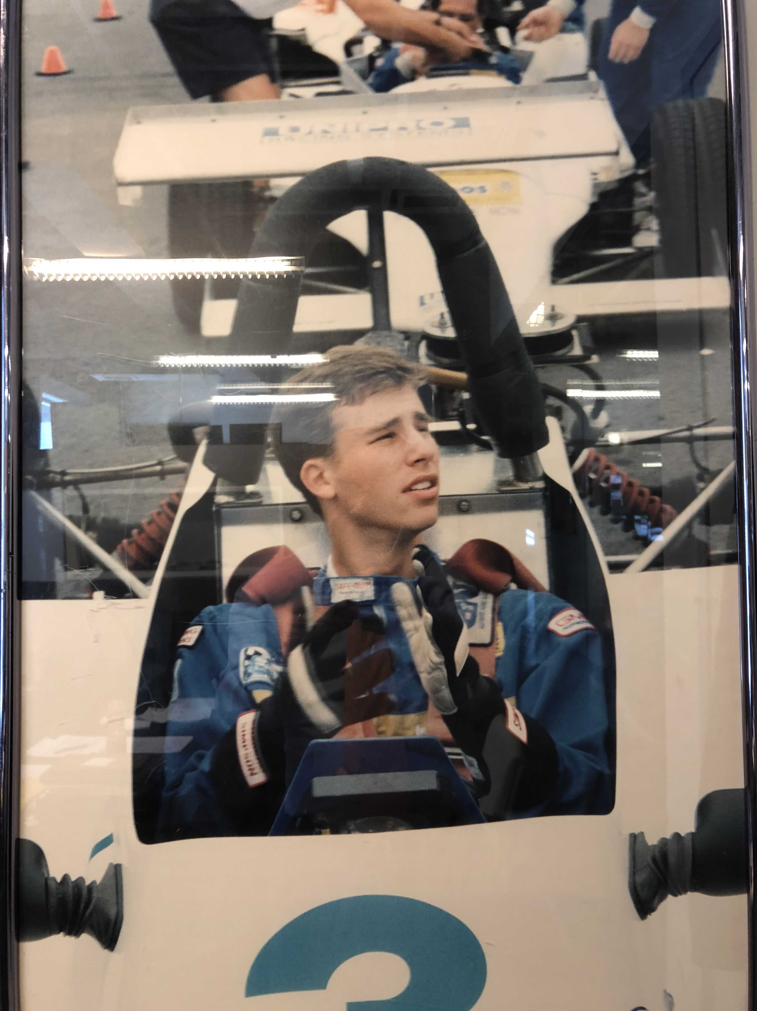
2. Channeling passion for the job to reach success
  Including the passion factor in organization’s vision, mission, and culture
If innovation is the engine, our passion is the fuel to go the distance

Slide 8

If you’re unsure if something is truly sparking passion, it can be helpful to be honest with yourself and ask the following questions.
  Would you do it for free?
  Does it make you feel good about yourself?
  Does it make you want to get out of bed in the morning?
  Do you talk about it to anyone who will listen?
  Do you lose track of time when you do it?
  Would you like to spend more of your time doing it?

Slide 9
Including the Passion Factor in an organization’s:
- Vision
- Mission
- Culture

Slide 10
Breakout Rooms: #1
Lessons learned throughout a career defined by championing breakthrough solutions and innovations
Channeling passion for the job to reach success
  Including the passion factor in organization’s vision, mission, and culture
  Is there something about your career—or ideal career—that ignites your passion, and how might you channel that passion to be an innovator in your organization/field?

Slide 11
Agenda
Lessons learned throughout a career defined by championing breakthrough solutions and innovations
Channeling passion for the job to reach success
  Including the passion factor in organization’s vision, mission, and culture
Trusting personal intuition to create and innovate
  Incorporating that in organizational strategy and planning, namely in vision and mission.
Efficiently managing time and deadlines to enhance performance and productivity.

Slide 12

3. Trusting personal intuition to create and innovate
  Incorporating that in organizational strategy and planning, namely in vision and mission.
“Intuition is a very powerful thing, more powerful than intellect, in my opinion. That’s had a big impact on my work.”
-Steve Jobs

Slide 13

Channeling Your Intuition to Improve Business Decision-Making
Know Yourself
Trust Yourself
Be Patient
Let Go of the “Need to Be Right”

Slide 14
Channeling Your Intuition to Improve Business Decision-Making
Know Yourself
If you don’t know what you stand for, you can be pulled in any direction, and not necessarily the one that best serves you.

Slide 15
Channeling Your Intuition to Improve Business Decision-Making
Trust Yourself
Be willing to lean in if you feel a strong call to something, and don’t discount gut feelings of red flags.

Slide 16
Channeling Your Intuition to Improve Business Decision-Making
Be Patient
Sometimes the answers won’t come right away; don’t stress about it.

Slide 17
Channeling Your Intuition to Improve Business Decision-Making
Let Go of the “Need to Be Right”
Let go of the pressure that comes with black and white thinking—one choice will lead to success, or the wrong one will lead to failure.

Slide 18
Channeling Your Intuition to Improve Business Decision-Making
Know Yourself
Trust Yourself
Be Patient
Let Go of the “Need to Be Right”

Slide 19
Incorporating intuition in organizational strategy and planning, namely in vision and mission.

Slide 20
Breakout Rooms: #2
Trusting personal intuition to create and innovate
  Incorporating that in organizational strategy and planning, namely in vision and mission.
  How have you used intuition in your career decision-making?
  How would you use it differently, based on what you just learned?

Slide 21
Agenda
Lessons learned throughout a career defined by championing breakthrough solutions and innovations
Channeling passion for the job to reach success
  Including the passion factor in organization’s vision, mission, and culture
Trusting personal intuition to create and innovate
  Incorporating that in organizational strategy and planning, namely in vision and mission.
Efficiently managing time and deadlines to enhance performance and productivity.

Slide 22
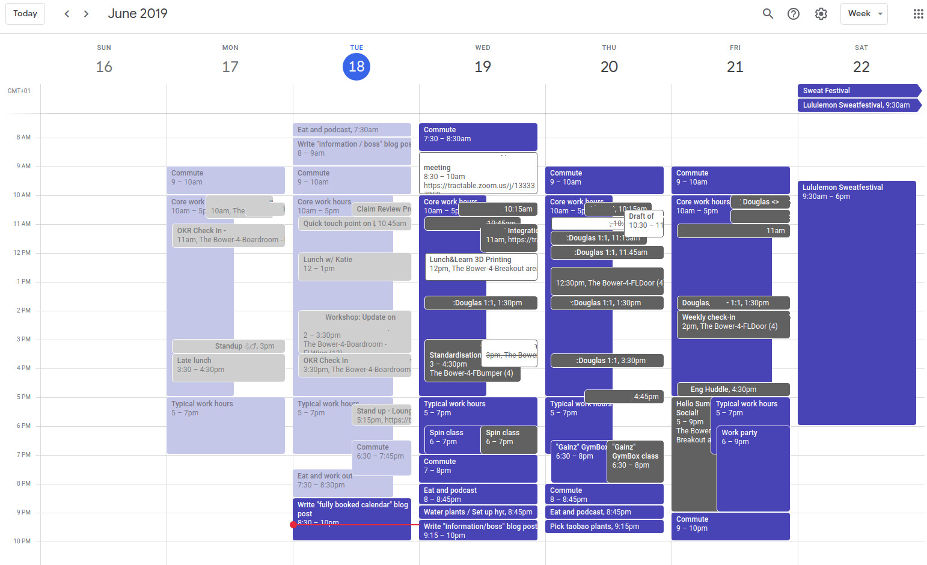
4. Efficiently managing time and deadlines to enhance performance and productivity.
Time management is the strategy of planning out your available time and controlling the amount of time you spend on specific tasks in order to work more efficiently. Without strong time management, your work and wellbeing can suffer.

Slide 23
Benefits of Mastering your Calendar:
Enhanced Performance: Mastering your calendar will help you enhance your performance as you will get a better idea of everything you need to accomplish and how long each task should take.
Better Work Delivered: Not racing to meet a deadline means you can put more effort and thought into your work.
Decreased Stress: Giving yourself enough time to accomplish a task can help reduce your stress levels.
Improved Career Opportunities: Being a more reliable employee who submits high-quality work on time improves your reputation and can create new career opportunities.
Boosted Confidence: Successfully meeting your deadlines will help you feel a sense of accomplishment and confidence in your abilities.
Greater Efficiency: Understanding how to manage your time effectively makes you more focused and allows you to accomplish more with less time available.

Slide 24
Benefits of Mastering your Calendar:
Enhanced Performance: Mastering your calendar will help you enhance your performance as you will get a better idea of everything you need to accomplish and how long each task should take.

Slide 25
Benefits of Mastering your Calendar:
Better Work Delivered: Not racing to meet a deadline means you can put more effort and thought into your work.

Slide 26
Benefits of Mastering your Calendar:
Decreased Stress: Giving yourself enough time to accomplish a task can help reduce your stress levels.

Slide 27
Benefits of Mastering your Calendar:
Improved Career Opportunities: Being a more reliable employee who submits high-quality work on time improves your reputation and can create new career opportunities.

Slide 28
Benefits of Mastering your Calendar:
Boosted Confidence: Successfully meeting your deadlines will help you feel a sense of accomplishment and confidence in your abilities.

Slide 29
Benefits of Mastering your Calendar:
Greater Efficiency: Understanding how to manage your time effectively makes you more focused and allows you to accomplish more with less time available.

Slide 30
Benefits of Mastering your Calendar:
Enhanced Performance: Mastering your calendar will help you enhance your performance as you will get a better idea of everything you need to accomplish and how long each task should take.
Better Work Delivered: Not racing to meet a deadline means you can put more effort and thought into your work.
Decreased Stress: Giving yourself enough time to accomplish a task can help reduce your stress levels.
Improved Career Opportunities: Being a more reliable employee who submits high-quality work on time improves your reputation and can create new career opportunities.
Boosted Confidence: Successfully meeting your deadlines will help you feel a sense of accomplishment and confidence in your abilities.
Greater Efficiency: Understanding how to manage your time effectively makes you more focused and allows you to accomplish more with less time available.

Slide 31

The Basics Go a Long Way…
Plan Ahead: Save your most important and challenging tasks for when your productivity is highest.
Prioritize Tasks: Determine what tasks are the most urgent and important and make those your top priority for the day.
Eliminate Distraction: Social media, phones and disruptive coworkers can all distract you from your priorities and derail your schedule.
Don’t Multitask: It may seem helpful, but in reality, multitasking actually decreases your productivity.
Reward Yourself: Give yourself a small reward for the tasks you accomplish in the day.

Slide 32
Discussion
Efficiently managing time and deadlines to enhance performance and productivity.
  What can you do to build time management into your daily routine to help drive better results?

Slide 33
Conclusion & Recap
Trust Your Intuition: The voice in our head is often the most important one. Listen to it and don’t let other people’s opinions drown out the courage to follow your heart and intuition.
Passion is 100% Required for Success: If you find work that is not only rewarding but also personally satisfying, then success will be in sight.
Time Is Not Always on Your Side: If you want to become more productive, try cutting your delivery deadlines in half—chances are you will get what needs to be done and be surprised at how well you did it.

Slide 34
Agenda: (What was covered)
Lessons learned throughout a career defined by championing breakthrough solutions and innovations
Channeling passion for the job to reach success
  Including the passion factor in organization’s vision, mission, and culture
Trusting personal intuition to create and innovate
  Incorporating that in organizational strategy and planning, namely in vision and mission.
Efficiently managing time and deadlines to enhance performance and productivity.

Slide 35
Q & A

Slide 36
Thank You!
Leave Your Feedback
foundationforeducation.org/feedback
Stay In Touch
info@foundationforeducation.org
All rights reserved. The information in this presentation shall be considered proprietary information not to be used, copied or reproduced in any way. No part of our presentations / workshops / webinars may be reproduced, distributed, or transmitted in any form or by any means, including photocopying, recording, or other electronic or mechanical methods.
Ethics, Innovation, & Inclusive Leadership
© 2022, All Rights Reserved

